Slide 1
Recent researches on DNN accelerators and research plan
Kenshu Seto

Slide 2
Brief introduction on Convolutional Neural Networks (CNNs)
Source:
Tutorial slides from “Hardware Architectures for Deep Neural Networks”, ISCA 2017
“Efficient Processing of Deep Neural Networks: A Tutorial and Survey,” V. Sze et al., Proceedings of the IEEE, 2017

Slide 3
Convolutional Neural Networks (CNNs)
CNNs are very good at various image recognitions tasks.
Each layer gets input images and generates output images
CNNs basically composed of only simple layers, that are,
Convolution layer, Activation layer, Pooling layer, Padding layer…
Convolutions accounts for more than 90% of overall computation

Slide 11
Convolution (CONVL) Layer computation (1 layer)
For each output pixel, do the following computation

Slide 12
CONV Layer C Implementation (Nest depth of 7)
Opportunity for loop optimization
loop tiling, interchange, were explored in many work, but not loop fusion
Can be used as a template for HLS

Slide 13
Pooling (POOL) Layer
After pooling, image sizes shrink (mismatch in loop size)
Not easy for loop fusion

Slide 14
POOL Layer C Implementation (Nest depth of 6)
For CONV layer followed by POOL layer, it looks better to fuse these layers to reduce # execution cycles but loop rewriting is necessary to match loop structures for loop fusion.
R, S: pooling window size
U : stride

Slide 15
Example CNN (VGG16, 2014)
Sequences of the same or similar CONV layers are used
Can fuse them for faster execution with less RAMs

Slide 16
Reducing

Slide 17
Fused-Layer CNN Accelerators M. Alwani et al., (MICRO 2015)
Notes:
This MICRO paper reduces the off-chip RAM access by placing the intermediate data between CNN layers on on-chip memory.

Slide 18
Data transfers in VGG19
Large portions of data transfer are feature maps (fmaps) between layers
Moving fmaps between off-chip and on-chip in accelerators results in high energy consumption
(note: VGG19 is a bit old. May exhibit different tendency in Recent DNN)

Slide 19
Data transfers in VGG19
Reduce off-chip memory accesses to reduce energy
Put fmaps in on-chip memory and use the data in on-chip memory
Feature maps (fmaps)
produced and consumed between layers should be on-chip RAMs and be reused to minimize the RAM size

Slide 20
Main idea: Pyramid
channel
output pixel 1 depends on tile(box)-shaped data from previous layers
like a pyramid
All intermediate data are stored in on-chip RAMs instead of off-chip RAMs
Reuse on-chip data to reduce data-transfer
Pyramid base
Pyramid top
Notes:
In order to generate an output pixel 1, tile-shape of pixels in the preceding layers over channels are used. So, the required data to compute an output pixel become a pyramid-like shape. When next output pixel 2 is computed, we don’t need to load whole data of the tile 2, since we can reuse the data in tile 1. So, only the new data for the tile 2 can be loaded from memory.

Slide 21
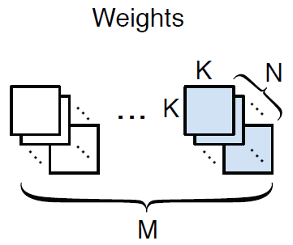
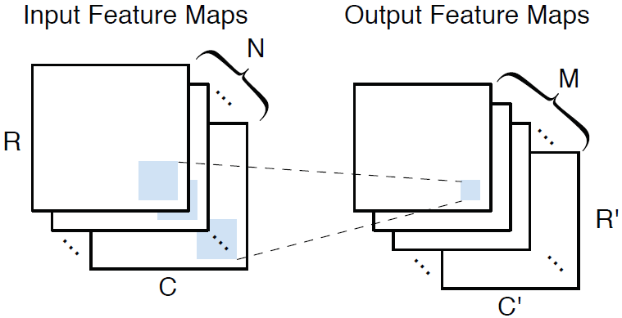
Proposed code for CONV layer
Simple C code
Image tile size varies to reuse and save computation
Move tile for
input/output
channels
loop of
tiled images
loop for kernel
Tiled output channel loop
Tiled input channel loop

Slide 22
Area/Performance tradeoff of a CONV layer
Resource and cycles are estimated from C code
Tile size T_{m} and T_{n} of output/input channels
Area constraint
=
=
Cycle counts
T_{c}
T_{r}

Slide 23
Task-level pipelining and DSE
Each CONV layer becomes a pipeline stage
Layers connected by ping-pong buffers
Pipeline initiation interval(II) equals to max stage time
Minimizing “max stage time” by changing T_{m} and T_{n}
Latency-minimized solution found by exhaustive search
# pyramids
64*64
(for example)
Should shrink due to
computation reuse
Pipeline
II
Stage time
Latency

Slide 24
Implementation detail
Task-level pipelining by HLS pragma
Iterations for final output
pixels (Pyramid top points)
Put “#pragma HLS dataflow”
“reuse layers” copy data between
input/output buffers in successive layers

Slide 25
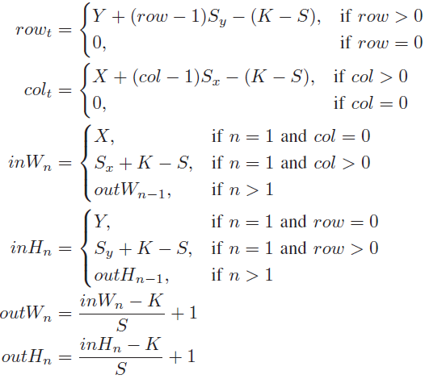
Symbols used in the implementation code
Elaborately developed to maximize reuse
row, col:
Coordinate of
Pyramid top
S_{x}, S_{y}:
stride of the adjacent
pyramid base

Slide 26
Inside the reuse layers
Output buffer of prev. layer are minimally copied to input buffer of next layer
Only new
data are
copied
Only new
data are
computed

Slide 27
FPGA Evaluation with Vivado HLS
Compare two designs (Fused-layer, Baseline)for VGG19
For fairness, match DSP resources between two designs
Fused-layer fused first 5 CONV layers in VGG19
Including pooling layers, etc
Baseline iteratively execute each layer
All feature maps stored in off-chip memory
Use ping-pong buffers to overlap computation and I/O transfer
DRAM bandwidth
significantly
reduced
rougly
the same
Matched
resources

Slide 28
Note on MICRO2015 paper
Pioneering work on fusing CNN layers for accelerator
Successfully fused CNN layers with task-level pipelining
Buffer management is a bit complex but effective
Task level pipelining has similar effects as loop fusion

Slide 29
Exploring Heterogeneous Algorithms for Accelerating Deep Convolutional Neural Networks on FPGAs. Xial et al., (DAC 2017)
Notes:
This is an paper that proposes the use of line buffers between fused layers.
This paper also proposes method to generate optimal fused architecture (where to fuse, including where
To use Winograd) under resource constraints in FPGAs.

Slide 30
Winograd algorithm for CONV layer
Reduces DSP (multiplier) units by ¼
More complex and additions are necessary
But requires 4x higher bandwidth
Utilize Winograd algorithm in fused CNNs
“Evaluating Fast Algorithms for Convolutional Neural Networks on FPGAs,”, FCCM 2017

Slide 31
Framework overview
Explained in the following slides
Parametrized
library
Design
point
DNN spec.
Design Space
Exploration
Vivado
HLS
fusion architecture
Line buffer type
Previous type
#Block RAMs,
#DSP units
Off-chip bandwidth,

Slide 32
Proposed Design Space Exploration
Objective
Minimize latency of total CNN execution
Under constraints on Resource R and data-transfer T (in MB)
For each layer, determine
Fusion group (layers in the same group are fused)
execute in a pipelined manner
reduce I/O bandwidth but increase RAM usage
Different groups execute exclusively and share resources
CONV algorithm type: Conventional or Winograd
Parallelism
Loop unroll factor, or # of data-path lanes
Solved by dynamic programming and branch-and-bound

Slide 33
C code generation for HLS with templates
After design space exploration, optimal C code for HLS is generated with appropriate parameter setting

Slide 34
Main idea: Use line buffer in Pyramid
Adopt Pyramid in MICRO2015 but without buffer management
Computation reuse between pyramid not described (causes a lot of overhead)
Within Pyramid, line buffers are used
channel x
(ex. conv1)

Slide 35
Result for VGG19 (First 5 conv + 2 pooling)
Used Vivado HLS
C simulation, C-RTL cosimulation
Compiled to ZC706 board
Transfer constraint
2MB
All layers must be fused
32MB
All feature maps can be stored in off-chip
With Winograd, higher performance achieved
Previous work [1]: MICRO2015 paper

Slide 36
Result for AlexNet (5 CONV + 3 Pool)
All layers fused
Compared to MICRO2015, 1.24X speedup
DSPs saved by Winograd algorithm are utilized by conventional CONV layers to enhance performance

Slide 37
Note on DAC2017 paper
Extends MICRO2015 with line buffers in pyramids
Buffer management in MICRO2015 not used
No computational reuse between Pyramid
RAM size seems to be reduced
Detail of method and experiment unclear
Use Winograd algorithm in CONV layer
Improve performance with area-efficient CONV layer
Possibly combine MICRO2015 pyramid with buffer management and line buffer?
Enable computational reuse and buffer size reduction

Slide 38
Research direction and plans

Slide 39
Research objective

Slide 40
General DNN accelerator environment
Looks
promising
Area?
Design Space
Explorer
Programmable
DNN accelerator
RTL,
code
DNN
Application
Development
Environment
(TensorFlow, Keras, …)
Program for
DNN accelerator
DNN
Description
(Ideal)
DNN accelerator implementation
environment
HLS
RTL of
DNN
ASIC,
FPGA
Target &
resource &
constraints
description
Compiler backend
Code
for
GPU,
CPU,
distributed
computing
Target
scope
Parametrized
code/architectural
template

Slide 41
Overall picture
C code
for DNN
Optimized
C code
Optimize
C code
DNN
Description
C code genarator
RTL of
DNN
FPGA
ASIC
DSE
(Analytical model)
HLS
Target &
resource &
constraints
description
C templates
conv, pool…
Loop opt.
Memory opt.
(In future,
automation)
A subset of C code is used as
intermediate
language
Action items
Define DNN description (subset)
Develop C templates
Develop C code generator
Optimize C code
Develop analytical model for DSE

Slide 42
Related work

Slide 43
Research plan
Develop template C code
Easier for loop optimization (fusion) and memory optimization
Conv (different strides with Activation), Pooling
Develop a generator tool
that generate C code from DNN descriptions
Keras can be used as DNN descriptions
Optimize the generated C code manually or semi-automatically
Loop fusion, interchange, tiling, …
Buffer optimization
Run Aladdin-gem5 for estimation
only for single thread code
Synthesize with Vivado-HLS
Use #pragma HLS DATAFLOW to do task level pipelining
Implement the previous work (DAC2017, MICRO 2015) and compare the results (resource, #cycles, etc)

Slide 44
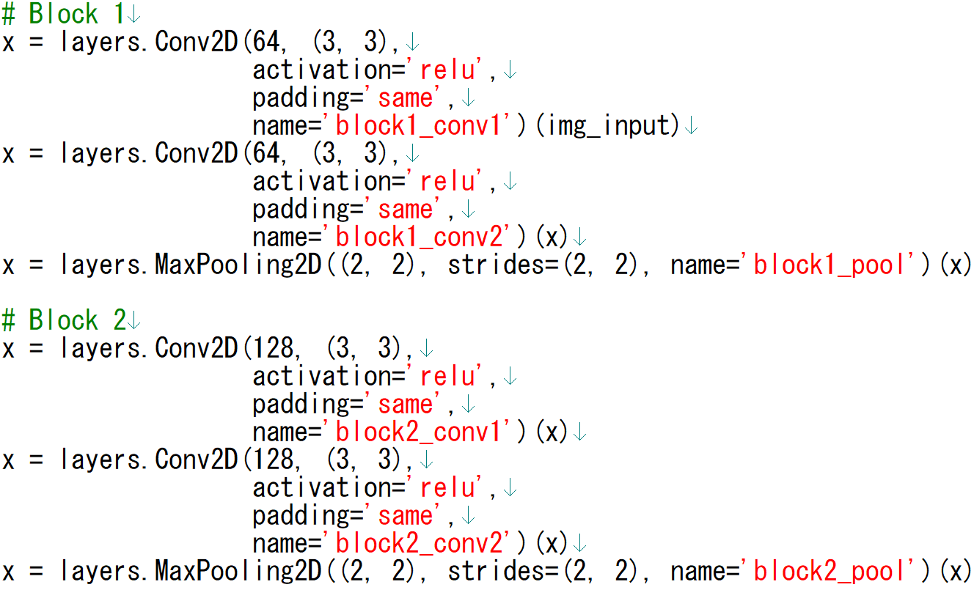
CNN description in Keras
Simple and helpful to define a DNN description language

Slide 45
Recent research on CNN accelerators

Slide 46
Maestro / Maeri

Slide 47
Tensor Comprehension

Slide 48
Summary

Slide 50
Research project at DRG: Design space exploration and memory access optimization for Deep Neural Network (DNN)

Slide 51
Summary of the project
Problem
Many accelerator exists, but mostly based on fixed templates
DNN models are changing, so fixed template may be suboptimal
Need to provide a efficient framework which generates the best DNN accelerator for ever-changing DNN models
Solution
Given a DNN model, generate HLS and optimizer friendly C code
With the code, explore design space and generate the best one
Key techniques
Alladin-gem5
System level performance estimation of accelerators with caches/scratchpads
Explore DNN design space which have not been explored yet
Memory optimizations
Memory accesses are bottleneck in DNN but maybe not explored enough yet
Apply (extended) memory access optimizations to DNN

Slide 52
Plan
Get HLS-synthesizable C code for DNN
At first, simple one is better to proceed
Define a target system architecture
List up and survey of most relevant DNN accel. work
State-of-the-art system architectures, DSE
State-of-the-art optimizations
Research
System level Design Space Exploration of DNN C code with Aladdin-gem5
Further effective optimization of DNN C code for HLS
Ideas from Post-quantum cryptography (Hamid)
Ideas from memory access optimizations for HLS
Automate them if possible

Slide 53
Get HLS-synthesizable C code for DNN
Possible candidates
TensorFlow, Caffe
Strength: Complete framework used by many organizations
Weakness: may not be easy to rewrite the C++ into HLS-aware C
YOLO
Strength: Complex application (image detection) written in C
Weakness: may not be easy to rewrite the code into HLS-aware C
GUINESS
Strength: Generates HLS-friendly simple C code, easy to modify
Weakness: Simple network (good starting point), binarized only
Provides both learning and inference
Network with conv layer (binalized), pooling layer supported

Slide 54
Basic Element of Neural Networks
Neuron
Multiply and Addition
Simple Non-linear element
f
Notes:
In neurons, each input x0, x1, … are multiplied by weights w0, w1, … and are summed up. So, in neural networks, a neuron basically does multiplication and addition. The results of the summation go through non-linear unit f and becomes the output of the neuron. Several non-linear activation functions exist, but Rectified Linear Unit (ReLU) is one of the most used activation functions, and it’s very simple. In this way, a neuron accepts inputs and generates an output value.

Slide 55
Basic (and abstract) Neural Network
Neurons are connected layer-by-layer.
Weights are computed by training with large data set.
Using neural network for classification is called inference.
w₀
w₁
Ex.
Input
image
Classification/
prediction
Results
(Cat, Dog, …)
Pixel
value
(More than one hidden layers)
Notes:
Each neuron explained in the previous slide are connected layer-by-layer. More specifically, the output value of a neuron becomes an input value of the other neuron in the next layer

Slide 56
Fully connected layer
DNN usually fully connected layer at the last stages
Weights contains many zeros, leading to sparse matrix multiply
Fully-connected and Sparsely-connected shows different characteristics
Ex. Convolutional
layer

Slide 57
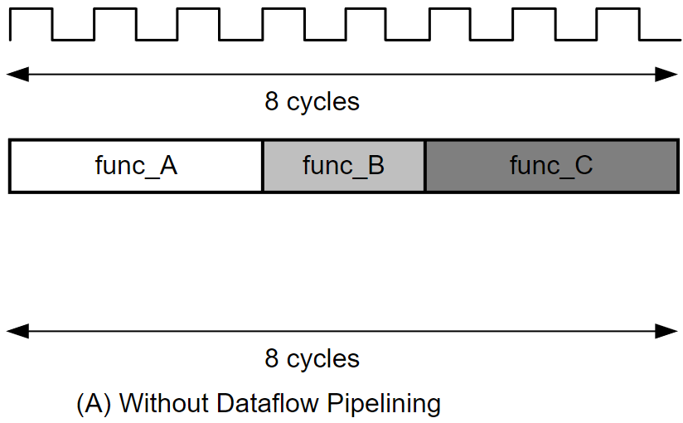
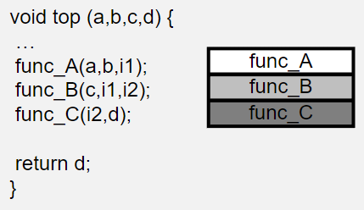
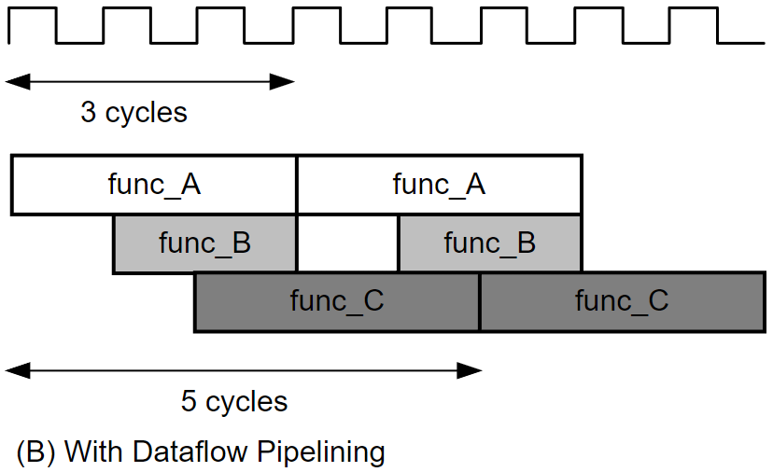
Implementation detail (Vivado HSL pragma)
Since each layer uses input buffer
#pragma HLS dataflow
func_A, B, C represents
Nested loops for CNN layers

Slide 58
Example CNN (ResNet)
Sequences of the same or similar CONV layers are also used

Slide 59
Experiments
VGGNet-E (VGG19)
fuse the following layers
first 5 conv + 2 pooling (DAC 2017, MICRO 2015)
Conv layers include ReLU and padding
(Probably, because of lack of resources, stop by 5 conv layers)
AlexNet
fuse the following layers
5 conv + 3 pooling (DAC 2017)
2 conv + 2 pooling (MICRO 2015)
neglecting normalization phase (incorporated in weights)

Slide 60
Background
Utilizing Winograd algorithm
Peak performance by the available hardware
Because of lack of bandwidth
Peak performance by the off-chip bandwidth

